Slide 1
Chapter 3: Process Management

Slide 2
Chapter 3: Processes
Process Concept
Process Scheduling
Operations on Processes
Interprocess Communication
Examples of IPC Systems
Communication in Client-Server Systems

Slide 3
Objectives
To introduce the notion of a process -- a program in execution, which forms the basis of all computation
To describe the various features of processes, including scheduling, creation and termination, and communication
To describe communication in client-server systems

Slide 4
3.1 Process Concept
An operating system executes a variety of programs:
  Batch system –executes jobs
  Time-shared systems –executes user programs or tasks
Process – a program in execution; process execution must progress in sequential fashion
A process includes:
  program counter
  stack
  data section

Slide 5
The Process
Multiple parts
  The program code, also called text section
  Current activity including program counter, processor registers
  Stack containing temporary data
    Function parameters, return addresses, local variables
  Data section containing global variables
  Heap containing memory dynamically allocated during run time
Program is passive entity, process is active
  Program becomes process when executable file loaded into memory
Two ways to load executable code to memory are-double clicking an icon representig executable file and entering name of executable file on command line.

Slide 6

Process in Memory

Slide 7
Process State
As a process executes, it changes state
  new: The process is being created
  running: Instructions are being executed
  waiting: The process is waiting for some event to occur
  ready: The process is waiting to be assigned to a processor
  terminated: The process has finished execution

Slide 8

Diagram of Process State

Slide 9
Process Control Block (PCB)/task control block
Information associated with each process
Process state
Program counter
CPU registers
CPU scheduling information
Memory-management information
Accounting information
I/O status information

Slide 10

Process Control Block (PCB)

Slide 11

CPU Switch From Process to Process

Slide 12
3.2 Process Scheduling
Multiprogramming is to have some processes running all the time to maximize the CPU utilization.
Time sharing objective is to switch CPU among processes so frequently that users can interact with each program while its running.
Process scheduler selects process among available processes for next execution on CPU.

Slide 13
Scheduling queues
Maintains scheduling queues of processes
  Job queue – set of all processes in the system, as the processes enter the system they are put into job queue.
  Ready queue – set of all processes residing in main memory, ready and waiting to execute.
  Device queues – set of processes waiting for particular I/O device
  Processes migrate among the various queues
  When process is allocated with CPU it executes for a while and eventually quits, interrupted ,waits for occurance of event like I/O completion.

Slide 14

Ready Queue And Various
I/O Device Queues

Slide 15

Representation of Process Scheduling/queing diagram

Slide 16
Schedulers
Process migrates among various queues throughout its lifetime.
Long-term scheduler (or job scheduler) – selects processes from pool of processes and loads them into memory for execution.
Short-term scheduler (or CPU scheduler) – selects one process among processes that are ready to execute and allocates CPU to one of them.

Slide 17
Schedulers (Cont.)
Short-term scheduler is invoked very frequently (executes atleast once every 100milliseconds) ⇒ (must be fast)
Long-term scheduler is invoked less frequently (seconds, minutes) ⇒ (may be slow)
The long-term scheduler controls the degree of multiprogramming(number of processes in memory)
Processes can be described as either:
  I/O-bound process – spends more time doing I/O than computations, many short CPU bursts
  CPU-bound process – spends more time doing computations; few very long CPU bursts

Slide 18
Contd..
If degree of multiprogramming is stable, then average rate of process creation must be equal to average departure rate of processes leaving the system.
Long term may need to be invoked only when process leaves the system.
Its important that long term scheduler selects good process mix of I/O bound and CPU bound processes.

Slide 19
Contd..
If all the processes are I/O bound then ready queue will almost be empty, short term scheduler will have little to do.
If all the processes are CPU bound then I/O waiting queue queue will almost be empty, devices go unused and system will be unbalanced.
Best performance system should have good combination of I/O bound and CPU bound processes.

Slide 20

Addition of Medium Term Scheduling to queing diagram

Slide 21
Contd..
Key idea behind medium term scheduler is that sometimes its better to remove processes from memory and thus reduce degree of multiprogramming.
Process can be reintroduced into memory, and its execution can be continued where its left off this is called swapping.
The process is swapped out and later swapped in by medium term scheduler.
Process is swapped out and later swapped in by medium term scheduler.
Swapping may be necessary to improve the process mix.

Slide 22
Context Switch
When CPU switches to another process, the system must save the state of the old process and load the saved state for the new process via a context switch.
Context of a process represented in the PCB
Context-switch time is pure overhead; the system does no useful work while switching
  The more complex the OS and the PCB -> longer the context switch
  Context switch speed varies from machine to machine depending on the memory speed and number of registers.
Time dependent on hardware support
  Some hardware provides multiple sets of registers per CPU -> multiple contexts loaded at once

Slide 23
Contd..
Occurance of interrupts also causes OS to change CPU from its current task and run kernel routine.
When there is a interrupt system saves current context of process currently running on CPU so that it can restore content when processing is done, essentially suspending a process and then resuming it.

Slide 24
3.3 Operations on processes
Process Creation:
The creating process is called parent process and the new process is called children of that process.
Parent process create children processes, which, in turn create other processes, forming a tree of processes
Generally, process identified and managed via a process identifier (pid)
When child is created it may get resources directly from OS or from the parent process.
Resource sharing
  Parent and children share all resources
  Children share subset of parent’s resources

Slide 25
Contd..
Execution
  Parent and children execute concurrently
  Parent waits until children terminate
When a new process is created, two possibilities in terms of execution:
Parent continues to execute concurrently with its children.
Parent waits until some or all of its children have terminated.
Two possibilities in terms of address space of new process.
Child process is duplicate of parent process( some data and program present as parent)
Child process has new program loaded into it.

Slide 26
Contd..
New process is created using fork() system call.
The new process consists of copy of address space of original process.
This mechanism allows parent to communicate easily with its child process.
exec() system call is to replace process’s memory space with new program.
Parent then can create children or issue wait() system call to move to ready queue waiting there until termination of child.

Slide 27

Process Creation using fork() system call

Slide 28
C program for creating a separate process using UNIX fork() system call
#include <sys/types.h>
#include <stdio.h>
#include <unistd.h>
int main()
{
pid_t pid;
/* fork another process */
pid = fork();
if (pid < 0) { /* error occurred */
fprintf(stderr, "Fork Failed");
return 1;
}
else if (pid == 0) { /* child process */
execlp("/bin/ls", "ls", NULL);
}
else { /* parent process */
/* parent will wait for the child */
wait (NULL);
printf ("Child Complete");
}
return 0;
}

Slide 29
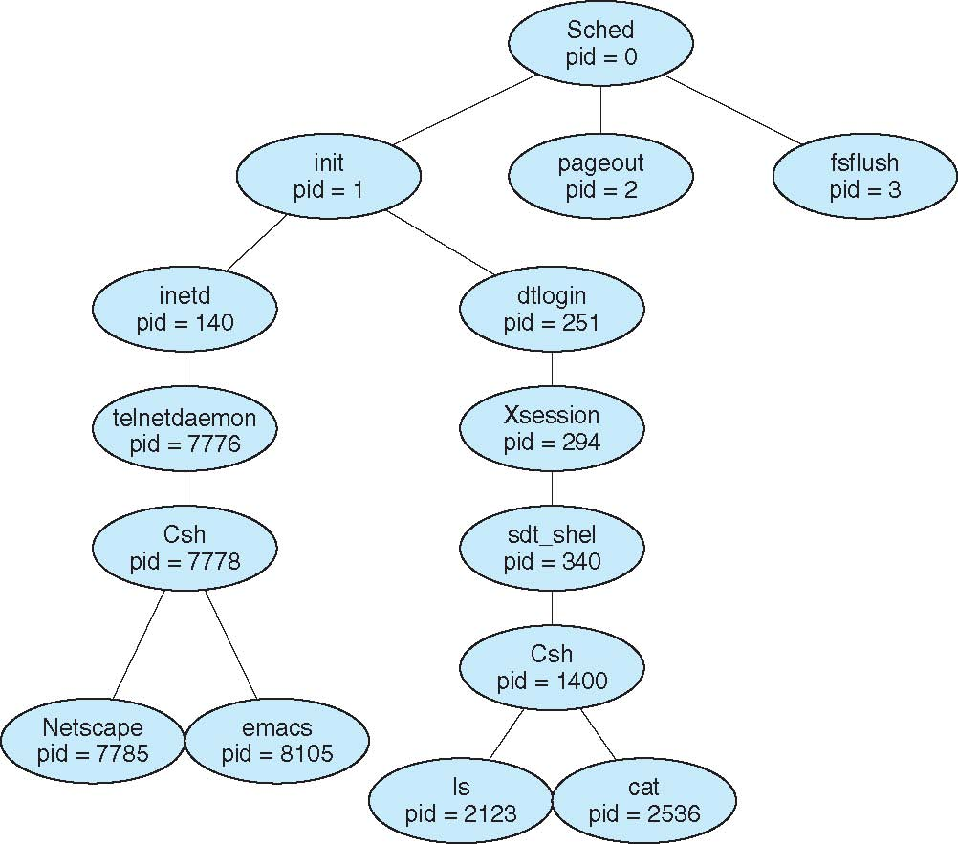
A Tree of Processes on Solaris

Slide 30
Process Termination
Process executes last statement and asks the operating system to delete it (exit)
  Output data from child to parent (via wait)
  Process’ resources are deallocated by operating system
Parent may terminate execution of children processes (abort)
  Child has exceeded allocated resources
  Task assigned to child is no longer required
  If parent is exiting
    Some operating system do not allow child to continue if its parent terminates.
    In such systems if process terminates all children terminated - cascading termination

Slide 31
InterProcess Communication(IPC)
Processes within a system may be independent or cooperating
Independent process cannot affect or be affected by other processes executing in the system.
Cooperating process can affect or be affected by other processes, including sharing data
Reasons for cooperating processes:
  Information sharing – several users may be interested in same piece of information. eg:shared file.
  Computation speedup-To run a task in faster way break it into subtasks ,each of which will be executing in parallel with others.

Slide 32
Contd..
  Modularity- divide system process into separate process or threads.
  Convenience- user doing multiple tasks at the same time . Eg: editing, printing, compiling.
Cooperating processes need InterProcess Communication (IPC)
Two models of IPC
  Shared memory
  Message passing

Slide 33
Message passing
In message passing model communication takes place by means of messages exchanged between the cooperating processes.
Message passing is useful for exchanging smaller amounts of data.
Message passing is easy to implement than shared memory for intercomputer communication.
Message passing systems are typically implemented using system calls which requires more time consuming task of kernel intervention.

Slide 34
Shared memory
In shared memory model region of memory that is shared by cooperating processes is established.
Processes can then exchange information by reading and writing data to the shared region.
Shared memory allows maximum speed and convenience of communication.
Shared memory is faster than message passing.
In shared memory system calls are required only to establish shared memory regions.

Slide 35

Communications Models (a)message passing, (b) shared memory

Slide 36
Shared memory Systems
Communicating Systems need to establish region of shared memory.
Shared memory region resides in the address space of the process creating shared memory segment.
Other processes that wish to communicate with this must attach to that address space.
Processes should ensure that both are not writing to same location simultaneously.
To illustrate cooperating processes take producer consumer problem.

Slide 37
Contd..
Producer process produces information that is consumed by consumer process.
Eg1: compiler may produce assembly code which is consumed by assembler.
The assembler may produce object modules which are consumed by loader.
Eg2:consider server as producer and client as consumer.
Server produces html files and images which are consumed(read) by client.
One solution to producer consumer problem uses shared memory.

Slide 38
Contd..
To allow producer and consumer run concurrently we must have buffer of items which is filled by producer, emptied by consumer.
This buffer resides in memory that is shared by producer and consumer process.
Producer produces one item and consumer consumes one item.
Producer and consumer must be synchronized so that consumer doesnot try to consume item that has not been produced.

Slide 39
Types of buffers
Unbounded buffer: No practical limit on size of buffer.
Consumer may have to wait for new items but the producer can always produce new items.
Bounded buffer: Assumes fixed buffer size.
Consumer must wait if buffer is empty and producer must wait if buffer is full.

Slide 40
Shared memory is implemented as below
Circular array with two logical pointers in and out.
In points to next free position in the buffer.
Out points to first full position in the buffer.
Buffer is empty if in==out
Buffer is full when ((in+1)%BUFFERSIZE)==out

Slide 41
Bounded-Buffer –
Shared-Memory Solution
Shared data
      #define BUFFER_SIZE 10
      typedef struct {
      . . .
      } item;
      item buffer[BUFFER_SIZE];
      int in = 0;
      int out = 0;
Solution is correct, but can only use BUFFER_SIZE-1 elements

Slide 42
Bounded-Buffer – Producer
while (true) {
/* Produce an item */
while (( (in + 1) % BUFFER SIZE ) == out)
; /* do nothing -- no free buffers */
buffer[in] = item;
in = (in + 1) % BUFFER SIZE;
}

Slide 43
Bounded Buffer – Consumer
while (true) {
while (in == out)
; // do nothing -- nothing to consume
// remove an item from the buffer
item = buffer[out];
out = (out + 1) % BUFFER SIZE;
return item;
}

Slide 44
Interprocess Communication –
Message Passing
Mechanism for processes to communicate and to synchronize their actions without sharing same address space and useful in distributed environment where communicating processes reside on different computers connected by network.
Message passing facility provides two operations:
  send(message) – message size fixed or variable
  receive(message)
If P and Q wish to communicate, they need to:
  establish a communication link between them
  exchange messages via send/receive
Implementation of communication link
  physical (e.g., shared memory, hardware bus)
  logical (e.g., logical properties)

Slide 45
Methods of communication
Direct or indirect communication
Synchronous and Asynchronous communication
Automatic or explicit buffering

Slide 46
Contd..
Communication between processes requires following things:
Naming
Synchronization
Buffering

Slide 47
Naming
Processes that want to communicate must refer to each other, they can use direct or indirect communication.
Direct Communication:
Processes must name each other explicitly:
  send (P, message) – send a message to process P
  receive(Q, message) – receive a message from process Q
Properties of communication link
  Links are established automatically
  A link is associated with exactly one pair of communicating processes
  Between each pair there exists exactly one link
  The link may be unidirectional, but is usually bi-directional

Slide 48
Contd..
Here both sender and receiver process must name each other to communicate which is called symmetry in addressing.
Asymmetry in addressing: here only sender names recipient ; recipient is not required to name the sender.
send(P,message)
receive(id,message) – receive message from any process. Variable id is set to name of process with which communication has taken place.

Slide 49
Indirect Communication
Messages are sent to and received from mailboxes (also referred to as ports)
  Each mailbox has a unique id
  Processes can communicate only if they share a mailbox
Properties of communication link
  Link established only if processes share a common mailbox
  A link may be associated with more than two processes
  Each pair of processes may share several communication links
  Link may be unidirectional or bi-directional

Slide 50
Indirect Communication
Operations
  create a new mailbox
  send and receive messages through mailbox
  destroy a mailbox
Primitives are defined as:
send(A, message) – send a message to mailbox A
receive(A, message) – receive a message from mailbox A

Slide 51
Indirect Communication
Mailbox sharing
  P₁, P₂, and P₃ share mailbox A
  P₁, sends; P₂ and P₃ receive
  Who gets the message?
Answer depends on
  Allow a link to be associated with at most two processes
  Allow only one process at a time to execute a receive operation
  Allow the system to select arbitrarily the receiver. Use round robin algorithm to select which process receives message.

Slide 52
Synchronization
Message passing may be either blocking or non-blocking
Blocking is considered synchronous
  Blocking send : sender is blocked until the message is received by receiving process or mailbox.
  Blocking receive : receiver is blocked until a message is available
Non-blocking is considered asynchronous
  Non-blocking send has the sender send the message and continue
  Non-blocking receive has the receiver receive a valid message or null

Slide 53
Buffering
Whether communication is direct or indirect messages exchanged are kept in temperory queue.
Queue of messages attached to the link; implemented in one of three ways
  1. Zero capacity – Queue has maximum length zero. Link can’t have any messages waiting in it. Sender must block until receiver receives.
  Bounded capacity – queue has finite length n. Thus n messages can be kept in it.
  If queue is not full sender sends message and its kept in queue and sender executes.
  If queue is full sender must block until space is available in queue.

Slide 54
Contd..
  3. Unbounded capacity –queue length is infinite. Any number of messages can be kept in it. Sender never blocks.

Slide 55
End of Chapter 3

